Slide 1
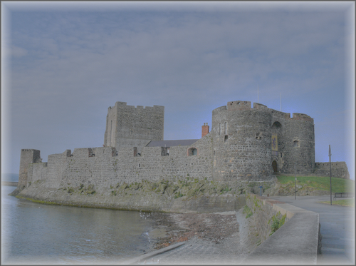



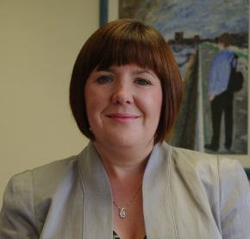
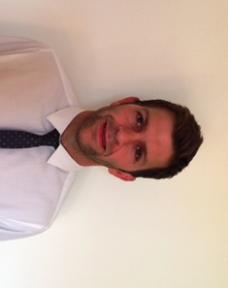
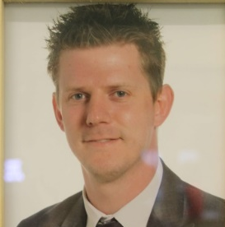

CLC
Induction Presentation
Notes:
1

Slide 2
Aims
Make students and parents aware of the daily running of CLC
Feel confident that our CLC students’ well-being and academic progress is central to this process
Notes:
2

Slide 3
Induction Process 1
Pupil Induction
Wednesday 1st September at 2.30pm
Visit host school
Opportunity to meet:
  Fellow travelling CLC classmates
  Subject teachers
  Coordinators
  Child Protection Officers
  Principals

Slide 4
Induction Process 2
First lesson induction
Thursday 2nd September:
First CLC subject class
Ice breaker activities
Kick start the process of getting to know classmates and teacher(s)

Slide 5
Induction Process 3
Induction Presentation
Provide details for parents/guardians and students regarding the processes involved in CLC.
Notes:
5

Slide 6
People involved in CLC
Students
Parents/guardians
Subject Teachers
CLC Coordinators
Child Protection Officers
Principals
Mrs Baird (external CLC Coordinator)

Slide 7
Students
Adhere to terms of their student contract
Good attendance – greater than 95% is expected
Comply with deadlines and work hard towards their goal
Ask for help no matter what the issue
Arrive for taxis and to all classes in good time

Slide 8
Parents or Guardians
Your role is vital
Please encourage your son/daughter to work hard at their academic studies
Attend Parent Interviews in your child's host school
If issues arise it is essential you communicate with CLC coordinators / Year Teams in your daughter/son’s own school

Slide 9
Subject Teachers
Teaching to agreed examination boards /specifications
Homework, coursework and portfolio completion
Monitor, track and set targets for student progress
Provide feedback to student and parents via parents’ evenings and reports (Spring Term)
Liaise with CLC Coordinator

Slide 10
CLC Coordinators
Oversee process
Resolve problems
Communicate with other CLC Coordinators
Communicate with parents

Slide 11
Child Protection Officers
Deal with any issues related to child protection
Students will have/have had the opportunity to meet with the designated Teacher in Charge of Child Protection in their host school

Slide 12
Transport
CLC classes have three timetable sessions:
9.00-11.00, 11.30-12.30 and 1.30-3.25 (ish)
Students make their own way to and from their host school at the start and end of the day
During the school day pupils will taxi/walk between schools.
No taxis between CGS and C Ac.
Taxi shuttle by Mahoods Taxis
All drivers are Access NI approved

Slide 13
Transport arrangements in practice
Session 1: 9am-11am:
Make your own way to your host school
Sign in and be IN class for 9am
Class ends at 11am
Sign out of the host school
Make your way to the taxi pick up point for 11.05am
Get into the correct taxi with your peers

Slide 14
Transport arrangements in practice
Session 2: 11.30am-12.30pm
Taxi leaves home school at 11.20am sharp
Sign in at host school and be in class for 11.30am
Lesson ends at 12.30pm
Sign out of the host school
Make way to taxi pick up point
Taxi leaves at 12.35pm to return you to your home school

Slide 15
Transport arrangements in practice
Session 3: 1.30pm-3.25pm(ish)
Taxi leaves home school at 1.20pm sharp
Sign in at host school and be in class for 1.30pm
Lessons end at the closing time of your host school
Make your own way home

Slide 16
School Holidays
If a class is running in your host school, even though your home school is closed, you are still expected to attend class (in school uniform) in order to receive your full quota of teaching time
Combined schools’ holiday list will be provided by your CLC coordinator and will be available on your school website.

Slide 17
Key documents
Please read, sign and return:
  Student contract
  Student information sheet
Please read and keep safe:
  CLC induction booklet
  CLC combined holiday list

Slide 18
Other queries
Uniform – always worn to your host school, with the exception of educational trips/visits (where relevant) or non-uniform days in your home school.
Educational visits – please let your home/host school know.
When in your host school, you follow the rules/expectations of that school.
Driving to host school.

Slide 19

Questions?
Notes:
19

